Slide 1

NOAA’s Satellite Status Report
GODEX-nwp Meeting
Lannion, France
May 16-19, 2017
John Paquette
NOAA/NESDIS/OSPO

Slide 2
NESDIS Office of Satellite and Product Operations (OSPO)
Operates the Nation’s 17 environmental satellites:
  3 Geostationary (GOES-NOP) by NOAA
  3 Polar-Orbiting (NOAA-15, -18, -19) by NOAA
  6 Defense Meteorological Satellite program (DMSP) operated by NOAA
  2 OSTM Jason-2 & Jason-3 (Ocean Surface Topography Mission) - Joint NOAA, NASA, CNES, EUMETSAT effort
  1 Suomi National Polar-orbiting Partnership (NPP) by NOAA & NASA
  1 DSCOVR (Deep Space Climate Observatory) by NOAA
  1 COSMIC
  *GOES-R was launched on November 19, 2016. Transitioned to GOES-16 on November 30, 2016.
  *JPSS-1 is scheduled to launch on September 23, 2017.
2
Notes:
The NESDIS Office of Satellite and Product Operations (OSPO) currently commands and controls nations 16 environmental satellites (listed are various types).

Slide 3
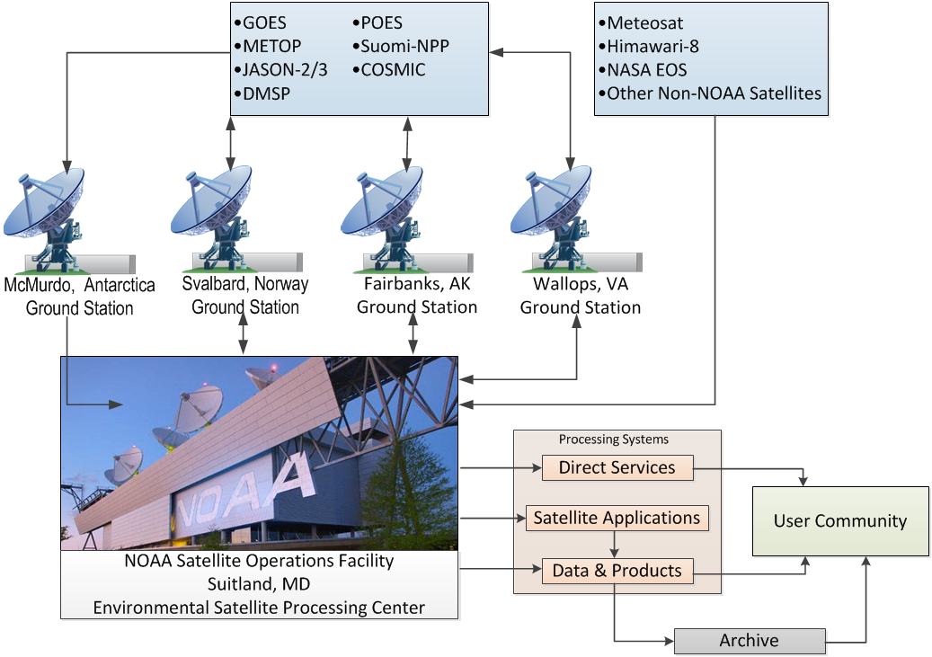
Operational Satellite Data Flow
3
Notes:
Here’s a depiction of the nominal satellite data flow as data from the satellites is ingested and processed by ESPC.
Processing systems provide the data to the user community and archive (NCEI).

Slide 4
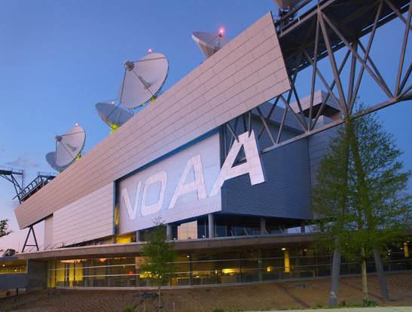
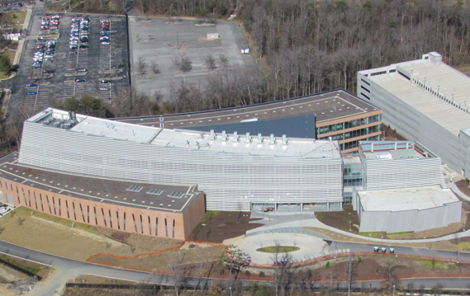
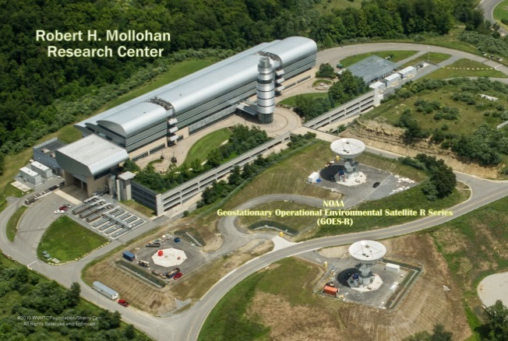
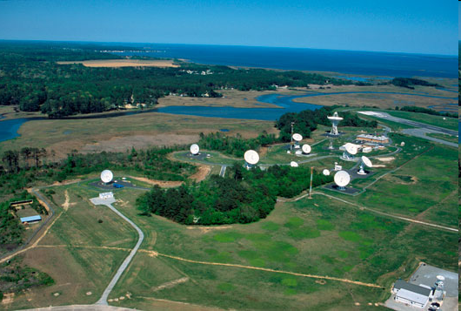
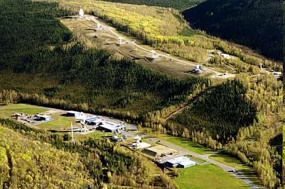
NOAA Operational Facilities
Over 500 staff supporting or operating the satellites, receptors, and processing systems
Suitland, MD
College Park, MD
Fairmont, WV*
Wallops, VA
Fairbanks, AK
* GOES-R and JPSS (New) Backup Facility
4
Notes:
OSPO has locations at four major facilities housing over 500 people.
NOAA Satellite Operations Facility (NSOF) in Suitland, Maryland
Mission Operations Division (MOD)
NOAA Center for Weather & Climate Prediction (NCWCP) in College Park, Maryland.
Satellite Product and Services Division (SPSD)
OSPO has Command and Data Acquisition Stations in Fairbanks, Alaska and Wallops, Virginia.

Slide 5
Current GOES Constellation Status

Slide 6
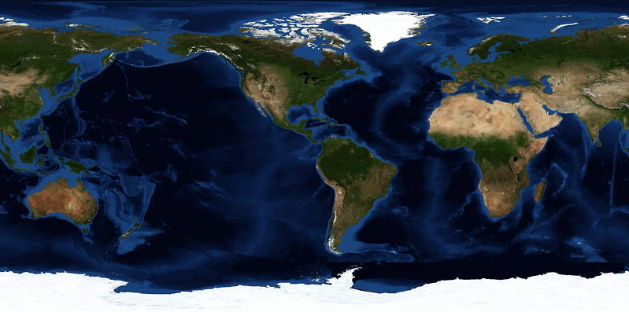
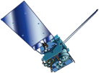
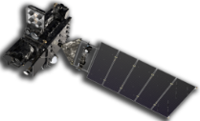
GOES Constellation
GOES-West
GOES-15
135° West
GOES-East
GOES-13
75° West
Standby
GOES-14
105° West
Checkout
GOES-16
89.5° West
GOES-15 | GOES-14 | GOES-16 | GOES-13
Launched: 3/2010 Located: 135°W GOES-WEST | Launched: 6/2009 Located: 105°W On-Orbit Storage | Launched: 11/2016 Located: 89.5°W Next GOES-East or West | Launched: 5/2006 Located: 75°W GOES-EAST
6
Notes:
After launch, the plan is to maintain the current GOES constellation until a decision is made regarding GOES-R positioning.
OSPO will continue to keep a standby satellite at 105w as backup to GOES-East and GOES-West.
GOES-R (after settling in at 89.5 degrees West position) will have a no effect on GOES-13/15 operations.
GOES Maintenance schedules will remain intact for legacy satellites.
The decision on positioning of GOES-R will depend on a number of factors:
The overall health of the entire GOES constellation and the needs of the user community.
Keep in mind, GOES-13 turned 10 years old this year and has existing issues (i.e. Sounder issue).
GOES-15 has only one healthy Star Tracker (ST1 & ST2 out). This and other considerations will factor into any decision.
Various other scenarios could come into play to influence GOES-R positioning and the fate of one of the spare satellites.

Slide 7
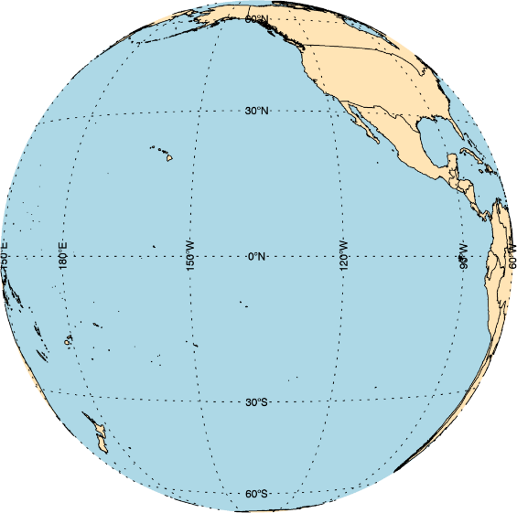
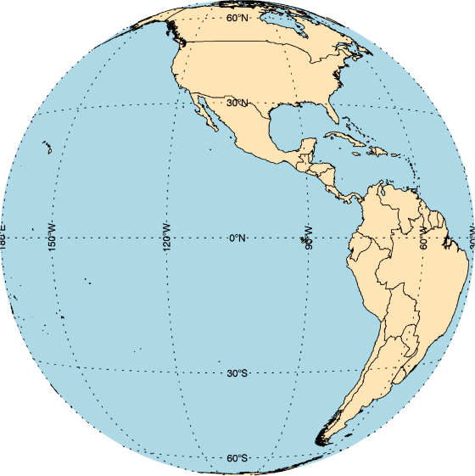
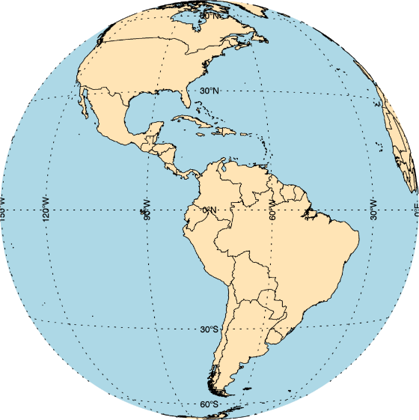
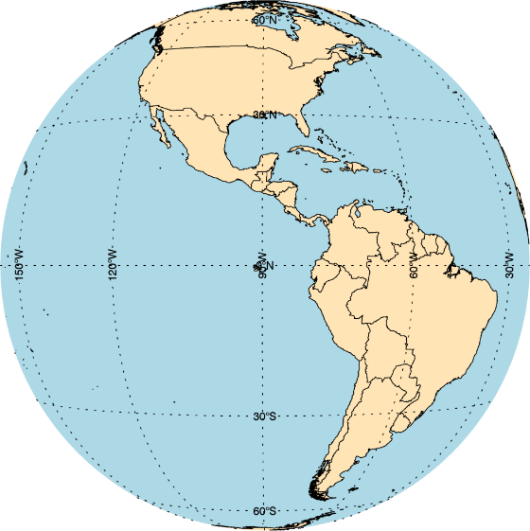

GOES Constellation
GOES-West
GOES-15
135° West
Standby
GOES-14
105° West
GGOES-East
GOES-13
75° West
GOES-R
Checkout
89.5° West
  Primary source of data for short term forecasting, especially of severe weather such as tropical storms
  Continuity of Operations since 1974
  Primary source of data for short term forecasting, especially of severe weather such as tropical storms
Continuity of Operations since 1974
7

Slide 8
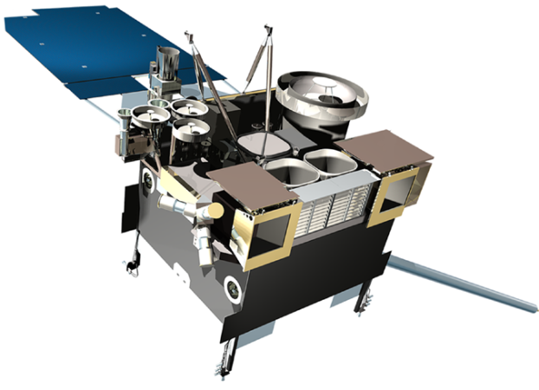
GOES Constellation Overview
Two operational satellite configuration
GOES East – GOES-13 at 75º W longitude
  Launched in May 2006
  Operational GOES East since April 2010
  Sounder filter wheel stalled in November 2015
    No Sounder products from GOES East.
  Star tracker #3 failed in August 2016
    Star Trackers #1 and #2 are used for attitude control.
    No impact for imagery products.
  Failed X-Ray Sensor (XRS) is functioning since 2013
  No plan to replace GOES-13 at this time
GOES West – GOES-15 at 135º W longitude
  Launched in March 2010
  Operational GOES West since December 2011
  Yaw-flip maneuver required due to Sounder cooler blanket anomaly
  Star trackers #1 and #2 failed. Continue to operate with the remaining star tracker #3
  Primary Solar X-ray Imager (SXI) and XRS instruments used for Space Weather Prediction Center
One on-orbit standby
GOES-14 at 105º W longitude as backup
  Launched in June 2009
  Spacecraft bus and instrument payload subsystems are nominal
  Can be activated to execute GOES East or GOES West schedule in 6 hours
  Provided short term 1-minute super rapid scan imagery data for GOES-R algorithm developers and research partners over the past 5 years

Slide 9
Geostationary Operational Environmental Satellite (GOES)
Operations Status
November 21, 2016
Payload Instrument | GOES-13 (East) Launch: May 06 Activation: Apr 10 | GOES-14 (Standby) Launch: Jun 09 Activation: | GOES-15 (West ) Launch: Mar 10 Activation: Dec 11
Imager | G | G | G
Sounder | R (1) | G | Y (5)
Energetic Particle Sensor (EPS) | G | G | G
Magnetometers | G | G | G
High Energy Proton and Alpha Detector (HEPAD) | G | G | G
X-Ray Sensor (XRS) | Y (2) | G | G
Solar X-Ray Imager (SXI) | Y (3) | G | S/C (6)
Spacecraft Subsystems
Telemetry, Command & Control | G | G | G
Attitude and Orbit Control | S/C (9) | G | Y (8)
Fuel for Inclination Control | G | G | G
Propulsion | S/C (4) | G | G
Mechanisms | G | G | G
Electrical Power | G | G | G
Thermal Control | G | G | G
Communications Payloads | G | G | S/C (7)
Key
Operational
Spacecraft issues but no user impacts
Operational with limitations
Non-operational
G
S/C
Y
R
9
Notes:
1
(1) GOES-13 Sounder filter wheel anomaly, Sounder frame sync losses, filter wheel stalls
Action
Operating with both windings on
Performed Sounder out-gassing
Modified SPS software to resolve frame sync issue
Performed FW power cycling 20 times daily, turned on outgas heater, commanded FW motor off for extended temperature cycling
Impact
Sounder pixel gaps/dropouts are minimized
Sounder IR data are not usable
(2) GOES-13 XRS capacitor short
Action
Performed tests on GOES-14 & 15 sensors to ensure failures will not be repeated
Using GOES-15 spacecraft to receive solar x-ray data
Impact
GOES-13 XRS X-ray measurements can potentially invert unexpectedly
No user impacts
(3) GOES-13 SXI detector damage due to flare
Action
Modified flight software to implement safing of SXI to prevent permanent damage
To modify flare detection algorithm
Impact
User impacts, 9 rows currently affected out of 512 total
(4) GOES-13 N2 thruster thrust force reduced
Action
Excluded N2/N3 thruster pair for North/South maneuver
Impact
No user impacts
(5) GOES-15 Sounder roll blanket raised above cooler
Action
User has been notified
Yaw flip at Equinox to keep Sun angle below cooler plane
Impact
Data outage and degraded products during each yaw flip maneuver and 28 hours of INR recovery period
(6) GOES-15 SXI initial power ON anomaly
Action
Not to power off SXI
Impact
No user impacts
(7) GOES-15 EMWIN SSPA in S-Band Receiver 1 failed
Action
Switched to use EMWIN SSPA and DCPI SSPA in S-Band Receiver 2
Impact
No user impacts
(8) GOES-15 Star Tracker 1 (ST1) failed, Star Tracker 2 (ST2) failed
Action
Turned on ST2 and switched to use ST2-ST3 configuration after ST1 failure in 2014
Operations with ST3 only after ST2 failure in 2015
Impact
Degraded INR performance under investigation using single Star Tracker
No redundant ST

Slide 10
Geostationary Operational Environmental Satellite (GOES)
Operations Status
November 21, 2016
Launch: May 2006 | Operational: April 2010
GOES-13 | Loss of Redun-dancy | Failure Within Lifetime | Failure Beyond Lifetime | Action Taken | Impacts
1. Sounder filter wheel anomaly, Sounder frame sync losses, filter wheel stalls |  |  |  | Operating with both windings on Performed Sounder out-gassing Modified SPS software to resolve frame sync issue Power cycled filter wheel windings, turned on outgas heater | Sounder pixel gaps/dropouts are minimized Sounder IR data are not usable
2. XRS capacitor short |  |  |  | Performed tests on GOES-O & P sensors to ensure failures will not be repeated Using GOES-15 spacecraft to receive solar x-ray data | GOES-13 XRS X-ray measurements can potentially invert unexpectedly Nominal XRS data since July 2013 No user impacts
3. SXI detector damage due to flare |  |  |  | Modified flight software to implement safing of SXI to prevent permanent damage Modified flare detection algorithm | User impacts, 9 rows currently affected out of 512 total
4. N2 thruster thrust force reduced |  |  |  | Excluded N2/N3 thruster pair for North/South maneuver | No user impacts
9. Star Tracker 3 (ST3) failed |  |  |  | Turned on ST2 and switched to use ST1-ST2 configuration after ST3 failure | No user impacts
Operational
Spacecraft issues but no user impacts
Operational with limitations
Non-operational
10
Notes:
GOES-13 ST3 failed on August 30, 2016

Slide 11
Geostationary Operational Environmental Satellite (GOES)
Operations Status
November 21, 2016
Launch: March 2010 | Operational: Dec 2011
GOES-15 | Loss of Redun-dancy | Failure Within Lifetime | Failure Beyond Lifetime | Action Taken | Impacts
5. Sounder roll blanket raised above cooler |  |  |  | User has been notified Yaw flip at Equinox to keep Sun angle below cooler plane | Data outage and degraded products during each yaw flip maneuver and 28 hours of INR recovery period
6. SXI initial power ON anomaly |  |  |  | Not to power off SXI | No user impacts
7. EMWIN SSPA in S-Band Receiver 1 failed |  |  |  | Switched to use EMWIN SSPA and DCPI SSPA in S-Band Receiver 2 | No user impacts
8. Star Tracker 1 (ST1) failed, Star Tracker 2 (ST2) failed |  |  |  | Turned on ST2 and switched to use ST2-ST3 configuration after ST1 failure in 2014 Operations with ST3 only after ST2 failure in 2015 | Degraded INR performance under investigation using single Star Tracker No redundant ST
Operational
Spacecraft issues but no user impacts
Operational with limitations
Non-operational
11

Slide 12
GOES Mission Life Estimate
(Based on Propellant Consumption)
As of: November 1, 2016
 | GOES-13 | GOES-14 | GOES-15
Launch Date | May 24, 2006 | June 27, 2009 | March 4, 2010
Propellant Load at Launch (kg) | 1665.70 | 1663.00 | 1664.10
Propellant Required For Orbit-Raising (kg) | 995.40 | 989.50 | 988.70
Propellant Remaining at Start of Orbital Operations (kg) | 670.30 | 673.50 | 675.40
Current Propellant Remaining (11/01/16) (kg) | 256.31 | 378.88 | 420.97
Reserves Not Included in Annual Usage (kg) 2 Station Relocations (1 deg/day drift) De-orbit (from normal mode) Fuel Bookkeeping Uncertainties | 10.5 10.5 21.0 | 10.5 10.5 21.0 | 10.5 10.5 21.0
Fuel Remaining For Normal Operations (kg) | 212.31 | 336.88 | 378.97
Average Annual Usage (kg) | 40.0 | 40.0 | 40.0
Fuel Mission Life Remaining (years/months) | 5yr/4mo | 8yr/9mo | 9yr/9mo
Time Remaining for a 15 year Mission | 4yr/7mo | 7yr/8mo | 8yr/5mo
12

Slide 13
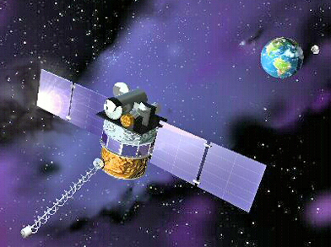
Deep Space Climate Observatory (DSCOVR)
Performance Status – Apr 26, 2017
Payload Instruments | Status
EPIC | G
PlasMag | G
NISTAR | G
Faraday Cup | G
ESA | G
Magnetometer | G
PHA | G
Spacecraft Subsystem | Status
Telemetry, Command & Control | G
Guidance, Navigation and Control | G
Attitude Control System | G
Propulsion | G
Mechanisms | G
Electrical Power | G
Thermal Control | G
Communications Payloads | G
Flight Software | G
1394 | G
Spacecraft | DSCOVR
Launch Date | Feb 11, 2015
Activation | June 2015
Operational (or capable of)
Operational with limitations (or in standby)
Operational with degraded performance
Functional but turned off
Not functional
No status reported
13
Notes:
1. . FC has lost peak tracking more frequently than anticipated (weekly instead of annually) during low space weather activity and when there is no command capability. OSPO is pursuing mitigation approaches with SWPC and NASA.
(Old note : New SW Patch loaded to disable auto full scan and enable it manually based on SWPC critical weather call.)
10/13/16: At 2126z (1746 ET) SWPC reported that DSCOVR Faraday Cup data was unusable and they had switched back to ACE for forecasting. Faraday Cup data
changed at 1928z (1528 ET), which we take to be the point where the Faraday Cup went offline. After consulting with SWPC and NASA Faraday Cup Engineers, OSPO Engineering performed troubleshooting commanding during the scheduled White Sands ranging pass (
2208-2308z / 1808 - 1908 ET).
The Faraday Cup software was halted at approximately 22:23z for several minutes, and then restarted at 22:26z; restarting the software performs a full scan/sweep. SWPC reported that the Faraday Cup data was nominal as of 22:26z. Faraday Cup data to SWPC was lost between 1928 - 2126z (when SWPC switched to ACE). Total outage was 1928 - 2226z (1528 - 1826 ET)
OSPO Engineering monitored the Faraday Cup data and the instrument’s behavior until the end of the scheduled WS1 pass (2308z / 1908ET. SWC personnel discussed options for either remaining on ACE overnight, or switching back to DSCOVR as prime. They decided to remain on ACE overnight due to the fact that there is a G3 watch out, and the current solar wind regime that gave DSCOVR FC problems remains the same. Engineering will verify the status of the instrument at AOS tomorrow. In this mode SWPC forecasters will not have visibility on DSCOVR performance.

Slide 14
GOES-R Series
GOES R, S, T, U
GOES-R launched November 19, 2016 at 6:42 pm EST
  Launched from: Cape Canaveral Air Force Station, Florida
  Vehicle: United Launch Alliance Atlas V (AV-541)
  Will assume operational position at East/West ~Nov. 2017
GOES-S launch March 2018
GOES-T launch 2019
GOES-U launch 2024
Each satellite is designed for 5 years of on-orbit storage and 10 years of operational use
GOES-R series designed to provide coverage through 2036
Position announcement will be made at the end of May

Slide 15
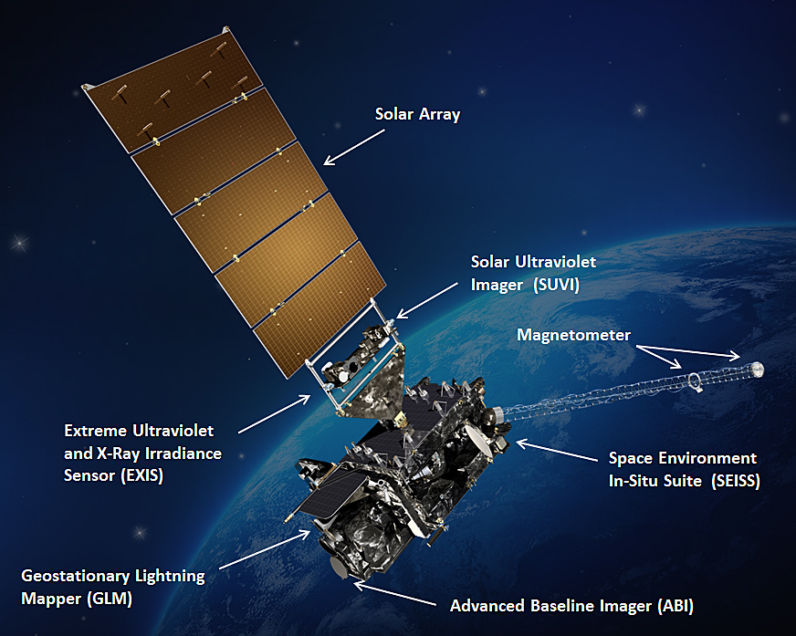
GOES-R Capabilities

Slide 16
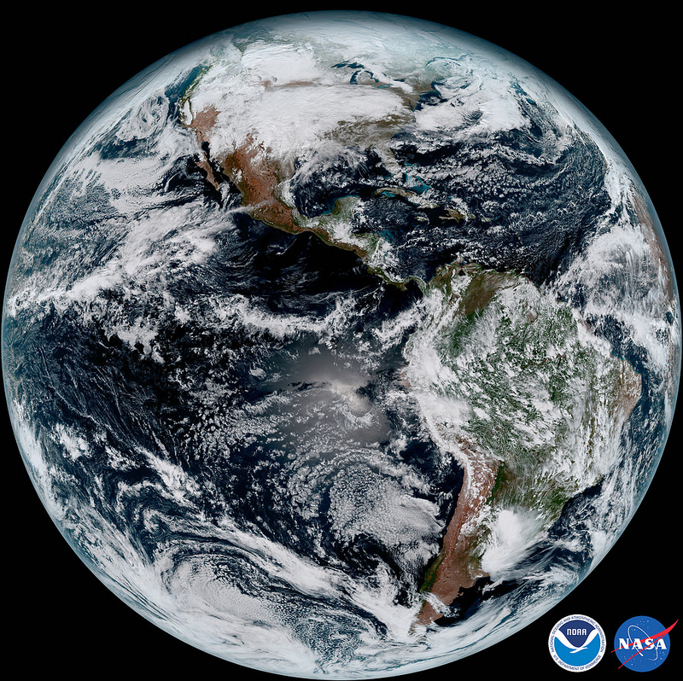
First Public Images – Full Disk
15 January 2017

Slide 17
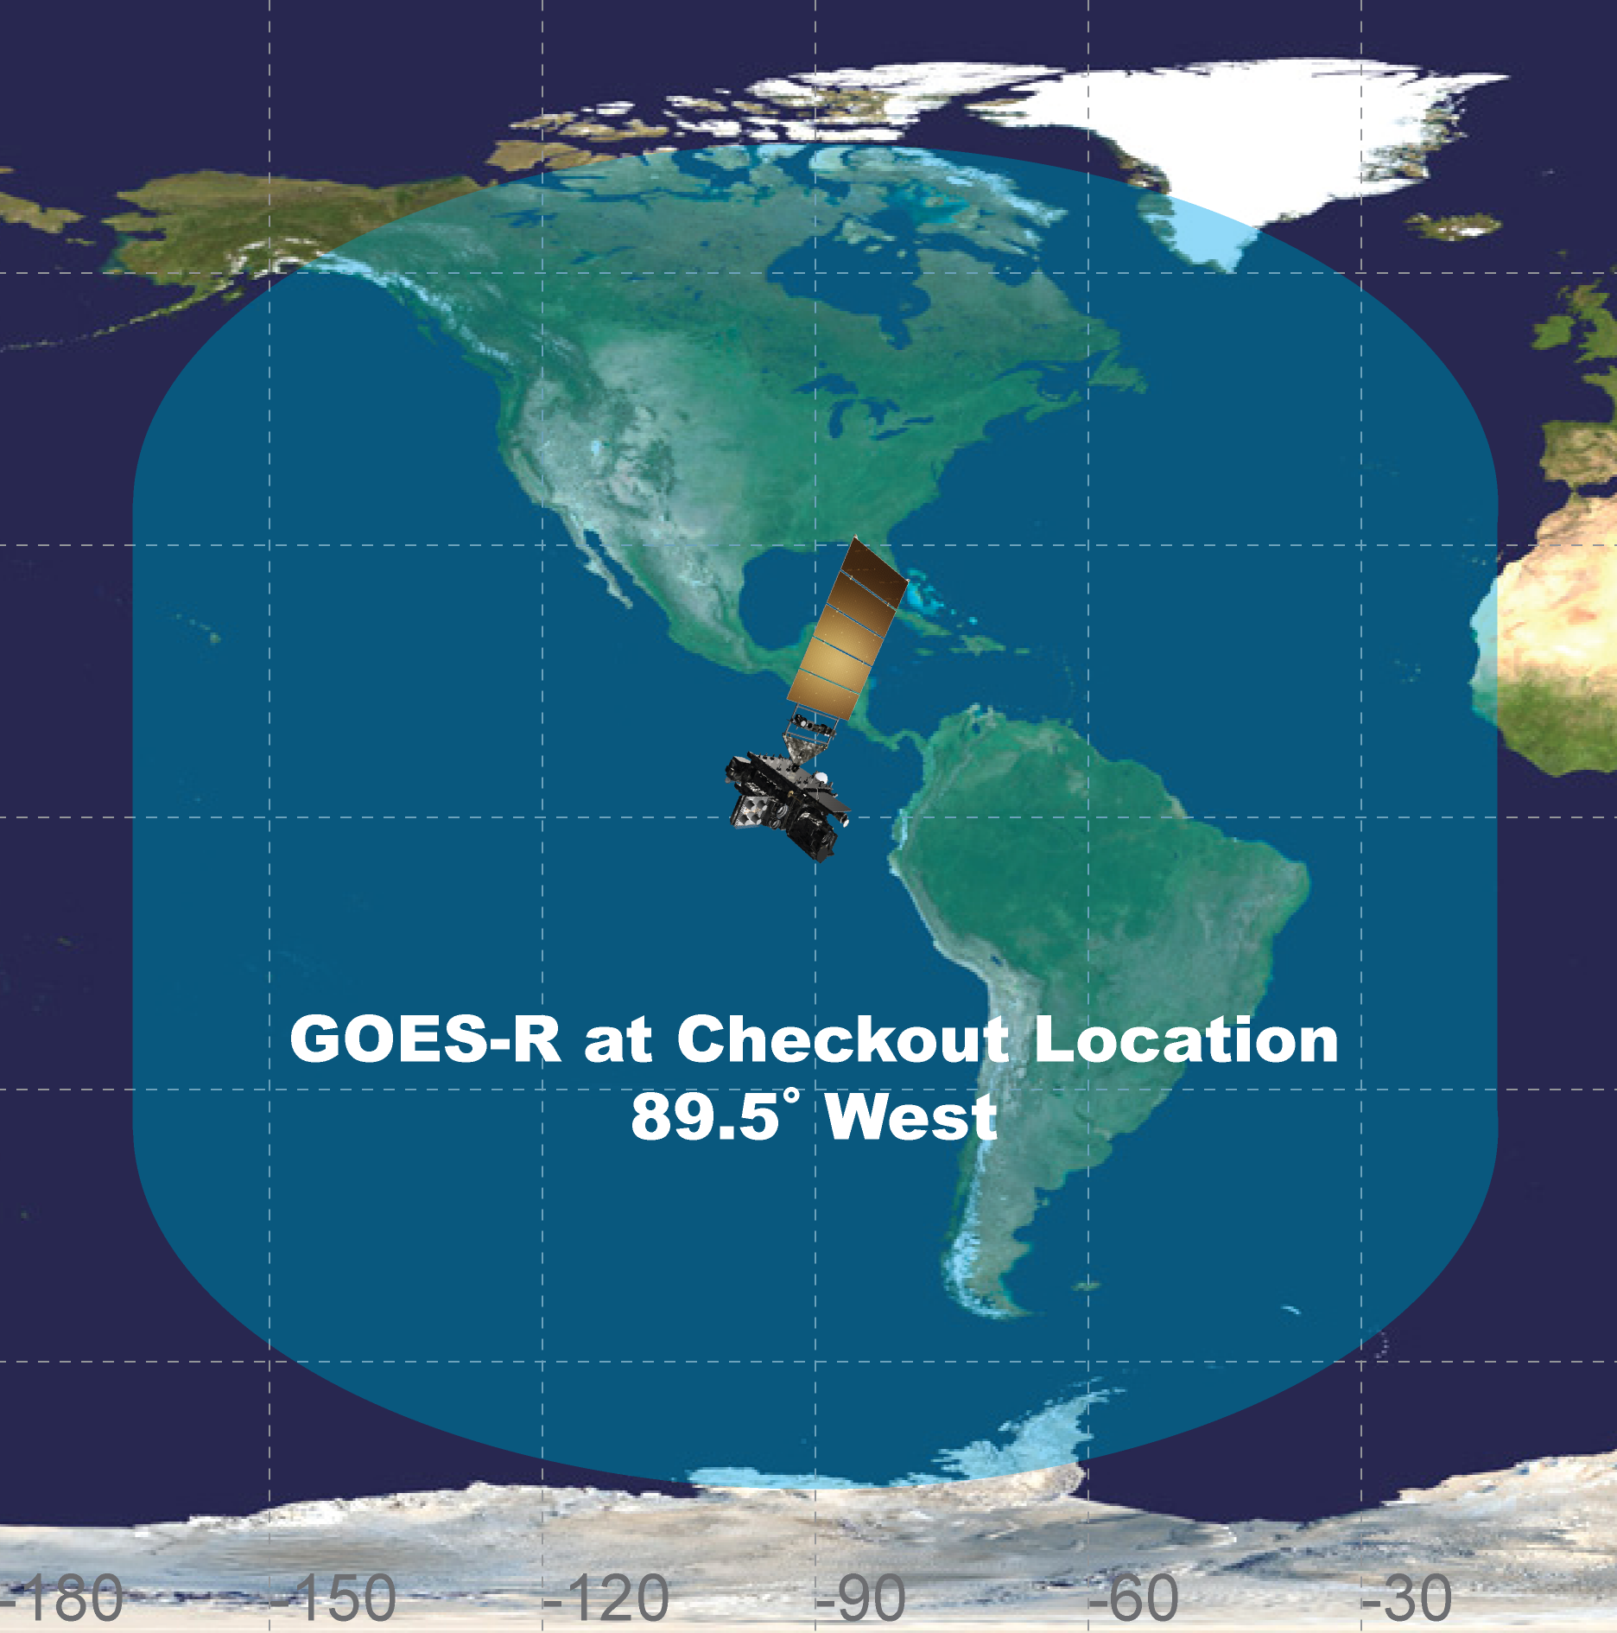
GOES-R Launch
GOES-R was launched successfully on November 19.
Launch and orbit raising completed nominally on December 5.
Level 1b products will be validated during Post Launch Test (six months) and will be available through GOES-R Rebroadcast (GRB) service as products are certified.
Level 2+ product certification begins after L1b products and those will be distributed on a product-by-product basis on the PDA as they mature.
17
Notes:
GRB Downlink Availability L+70 Days: Available to all. This is a precedent from all previous GOES missions. It is important to have our user community participating in verification of GRB distribution and receipt. Notifications will inform users of data caveats (e.g. beta status) ala on-orbit maneuver data caveats. There is no plan to cease GOES-16 data availability at any point after the GRB service is turned on.
L+45 days: Terrestrial data from Wallops to NSOF with PDA offering GOES-16 data availability for limited customers’ testing purposes
PDA will have data available to high priority customers including NCEP centers at L+45. Those data will be routed through a temporary delivery of data from Wallops through a terrestrial line to NSOF then made available to a limited set of customers via PDA. These data will have a ~1 second greater latency than normal operations, but sufficient for system readiness preparation.

Slide 18
The Advanced Baseline Imager:
ABI Current -
GOES-N to P
5 bands
Approx. 1 km n/a
Approx. 4 km
Spectral Coverage
Spatial resolution
0.64 μm Visible Other Visible/near-IR Bands (>2 μm)
Spatial coverage
16 bands
0.5 km
1.0 km 2 km
Full disk | 4 per hour | Scheduled (3 hrly)
CONUS | 12 per hour | ~4 per hour
Mesoscale | Every 30/60 sec | n/a
Visible (reflective bands)
On-orbit calibration
Yes
No

Slide 19
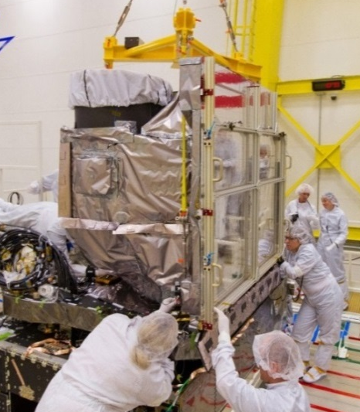
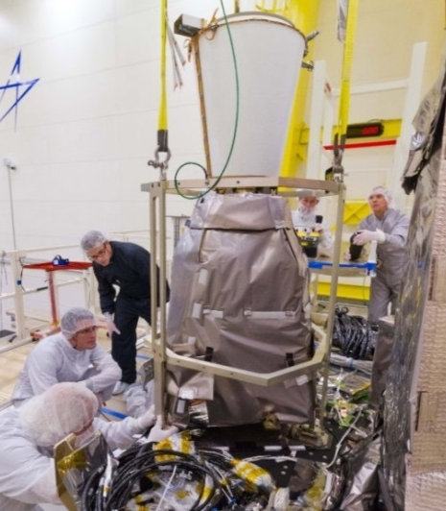
GOES-16 Earth-Pointing Instruments
Advanced Baseline Imager
  Primary instrument in GOES-R series
  16 channel imager
  Measures radiances in the visible and near-infrared wavelengths
  Improves every product from current GOES Imager and will offer new products for severe weather forecasting, fire and smoke monitoring, volcanic ash advisories, and more
  Improves upon current capabilities in spectral information (3X), spatial coverage (4X), and temporal resolution (5X)
ABI Integration
Geostationary Lightning Mapper
Detects total lightning activity across the Western Hemisphere
Provides coverage over oceans and land
Improved forecaster situational awareness and confidence resulting in more accurate severe storm warnings (improved lead time, reduced false alarms)
Data latency only 20 sec
GLM Integration
20

Slide 20
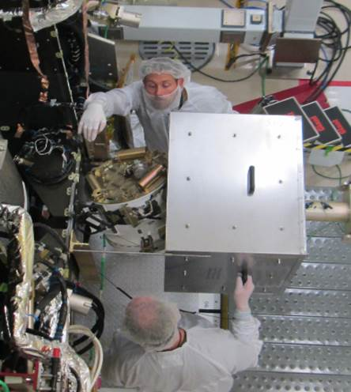
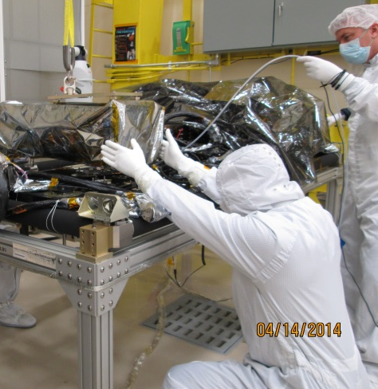
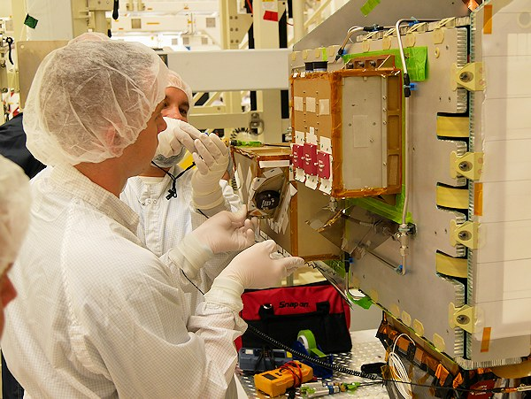
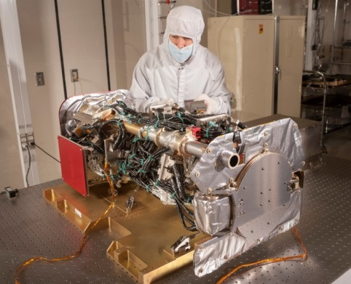
GOES-16 Space Weather Instruments
Space Environment
In Situ Suite (SEISS)
Magnetometer
Extreme Ultraviolet and
X-ray Irradiance Sensor (EXIS)
Solar Ultra-Violet Imager (SUVI)
Array of energetic particle sensors that will monitor the proton, electron and alpha particle fluxes
Assess radiation hazard to astronauts and satellites
Warn of high flux events, mitigating damage to radio communications and navigation systems
Measures the magnitude and direction of the Earth's ambient magnetic field
Provides map of the space environment that controls charged particle dynamics in the outer region of the magnetosphere
Detection of magnetopause crossings, sudden storm commencements, and substorms
The X-Ray Sensor (XRS) monitors solar flares that can disrupt communications and degrade navigational accuracy, affecting satellites, astronauts, high latitude airline passengers, and power grid performance.
Extreme Ultraviolet Sensor (EUVS) monitors solar variations that directly affect satellite drag/tracking and ionospheric changes, which impact communications and navigation operations.
Locates coronal holes, flares and coronal mass ejection source regions
Continuously images the sun in 6 extreme ultraviolet wavelengths to characterize active region complexity
Will provide an early warning of possible impacts to the Earth environment and enable better forecasting of potentially disruptive events
21
Notes:
3

Slide 21
GOES-16 Science Product
Validation Status
ABI L1b Product
Radiances
ABI L2+ Products (con’t)
Derived Stability Indices
Downward S/W Radiation: Surface
Fire/Hot Spot Characterization
Hurricane Intensity Estimation
Land Surface Temperature
Legacy Vertical Moisture Profile
Legacy Vertical Temperature Profile
Rainfall Rate/QPE
Reflected S/W Radiation: TOA
Sea Surface Temperature
Snow Cover
Total Preceptible Water
Volcanic Ash: Detection and Height
GLM L2 Product
Lightning: Events, Groups, Flashes
SEISS L1b Products
Energetic Heavy Ions
Magnetospheric e⁻/p⁺: Low Energy
Magnetospheric e⁻/p⁺: High Energy
Solar & Galactic Protons
EXIS L1b Product
Solar Flux: EUV
Solar Flux: X-ray Irradiance
SUVI L1b Product
Solar EUV Imagery
MAG L1b Product
Geomagnetic Field
ABI L2+ Products
Cloud and Moisture Imagery (CMI) and Sectorized CMI (KPP)
Aerosol Detection (Smoke & Dust)
Aerosol Optical Depth (AOD)
Clear Sky Mask
Cloud Optical Depth
Cloud Particle Size Distribution
Cloud Top Height
Cloud Top Phase
Cloud Top Pressure
Cloud Top Temperature
Derived Motion Winds

Slide 22
International GOES-R Training Request Process
Complete the Google form located on the GOES-R website under the training section:
http://www.goes-r.gov/users/training.html
Janel Thomas is POC and lead of a working group comprised of training and international affairs representatives from GOES-R, NESDIS, and NWS and will respond to the request
Requests will be honored depending on resource availability. At a minimum, virtual material can be provided.

Slide 23
PDA and GOES-16
PDA is providing GOES-16 data to CAL-VAL and approved Pre-Beta Users
Users need to be approved by GOES-R Chief Scientist for Early/Beta Access (current approved users include EUMETSAT, DoD, CMC, INPE, remaining NWS (especially NCEP Centers)
Product groups are tentatively scheduled as follows:
  Jun 5, 2017 - ABI L1b and CMI
  Dec 2017 - ABI L2+ (6 months after Handover to OSPO)
  All other products are tentatively scheduled to be provisional after Aug 16th, 2017

Slide 24






NOAA Geostationary Satellite Programs Continuity of Weather Observations
Calendar Year
09 10 11
As of March 2017
12 13 14 15 16 17 18 19 20 21 22 23 24 25 26 27 28 29 30 31 32 33 34 35 36
GOES-13
GOES East
60% Confidence
GOES-14
On-orbit spare
60% Confidence
GOES-15
GOES West
60% Confidence
GOES-16
Updated March 2017
GOES-S
GOES-T
GOES-U
Fiscal Year
09 10 11
12 13 14 15 16 17 18 19 20 21 22 23 24 25 26 27 28 29 30 31 32 33 34 35 36
_______________
In orbit, operational In orbit, storage
Planned in-orbit Storage Planned Mission Life
Approved: _ ___
Assistant Administrator for Satellite and Information Services
Reliability analysis-based extended weather observation life estimate (60% confidence) for satellites on orbit for a minimum of one year -- Most recent analysis: March 2017
24

Slide 25
Polar-Orbiting Status
25

Slide 26
Polar Payload Instrument Acronyms
AVHRR Advanced High Resolution Radiometer
HIRS High Resolution Infrared Radiometer
AMSU-A1 Advanced Microwave Sounding Unit
AMSU-A2 Advanced Microwave Sounding Unit
AMSU-B Advanced Microwave Sounding Unit
MHS Microwave Humidity Sounder
SEM Space Environment Monitor
SBUV Solar Back Scatter UV Spectral Radiometer
DCS Data Collection System
ADCS Advanced Data Collection System
SAR Search And Rescue: SARR and SARP
26

Slide 27
Definition of Color Status
Operational | G
Spacecraft Issue but no User Impact | S/C
Possible Impact to Products | P
Operational with Limitation | Y
Non-Operational | R
Not Applicable | N/A

Slide 28
Polar Operational Environmental Satellite (POES)
Operational Status
April 24, 2017
Spacecraft Subsystems | METOP-A | METOP-B | NOAA-19 | NOAA-18 | NOAA-15
Launch Date | Oct 2006 | Sept 2012 | Feb 2009 | May 2005 | May 1998
Operational Date | May 2007 | April 2013 | Jun 2009 | Aug 2005 | Dec 1998
Mission Data Category | Secondary (AM) | Primary (AM) | Prime Services Mission (PM) | Secondary (PM) | Secondary (AM)
Payload Instruments
AVHRR | G | G | G | G | Y(20)
HIRS | Y(37) | Y (33) | Y (32) | Y (3) | R (6)
AMSU-A1 | G | P (36) | G | G | Y(21)
AMSU-A2 | G | G | G | G | G
AMSU-B | N/A |  | N/A | N/A | R (12)
MHS | G | G | Y (8) | G | N/A
SEM | G | G | G | G | G
SBUV | N/A |  | S/C (9) | R(29) | N/A
Spacecraft Subsystems
Telemetry, Command & Control | G | G | G | G | G
ADACS | G | G | G | Y (7) | Y(10)
EPS | G | G | G | G | G
Thermal Control | G | G | G | G | Y(22)
Communications | Y (1) | G | G | G | Y(23)
APT/LRPT | R (2) | G | G | G | G
DCS | N/A | N/A | N/A | G | G
ADCS | G | Y(31) | G | N/A | N/A
SAR | G | Y(31) | G | G | Y(24)
27

Slide 29
POLAR Operational Environmental Satellite (POES)
Operations Status
April 24, 2017
METOP-A | Loss of Redun-dancy | Failure Within Lifetime | Failure Beyond Lifetime | Action Taken | Impacts
1. HRPT limited usage |  |  |  | Operated on a limited basis to extend life. HRPT available over Europe and North Atlantic | Limited coverage and availability for CONUS. Both Ascending and Descending orbit HRPT is available at this time
2. No LRPT |  |  |  | Transmitter off | No data available
37. HIRS Filter Wheel Noise |  |  |  | Operations continue with close monitoring of the filter wheel noise | Products generated with minimal impact.
Please Note: HRPT Extension of Service began 18 Jan 2011. WCDA will be able to see a few more pass for METOP-HRPT

Slide 30
POLAR Operational Environmental Satellite (POES)
Operations Status
April 24, 2017
METOP-B | Loss of Redun-dancy | Failure Within Lifetime | Failure Beyond Lifetime | Action Taken | Impacts
31. ADCS/SAR RF Loss of around 10 dB |  |  |  | Operations continue with on-going investigation on a limited basis | Limited coverage with around 35% less availability for Data Collection.
33. HIRS Long Wave Channels 5, 6 soon to be out of spec, Ch10 out of spec |  |  |  | Operations continue with close monitoring due to several IR Channels Noise Increases | Products generated with minimal impact.
36. AMSU A1 Ch. 15 Failure Ch. 7 Noisy |  |  |  | Investigation Complete. Channel 15 has been declared inoperative/failed. Instrument remains operational, though performance degraded Ch 7 was taken out of service do to noisy data. Noise has reduced, return to service uncertain. | MHS Ch. 1 is the same frequency as AMSU A1 Ch. 15 so MHS data can be used in its place. Ch 7. Metop-A is also out of spec, no mitigation

Slide 31
POLAR Operational Environmental Satellite (POES)
Operations Status
April 24, 2017
NOAA-19 | Loss of Redun-dancy | Failure Within Lifetime | Failure Beyond Lifetime | Action Taken | Impacts
8. MHS H3 have stabilized; operating dynamic ranges decreased |  |  |  | MHS H3 remains out of spec | Adverse impact on products
9. SBUV Lamp Door Anomaly |  |  |  | Lamp door potentially stuck. Discontinued commanding lamp door for calibration. | Potential impact if calibrations are discontinued, so far no adverse impact for users.
32. HIRS Long Wave Channel Noise Increased |  |  |  | Filterwheel motor in Hi power mode and filterwheel housing heater turned on. | Adverse impact on products. STAR scientist and user community are re-evaluating for options.
34. ADCS RX1 produces TLM corruption |  |  |  | Operations continue with on-going investigation on a limited basis | Redundancy is lost

Slide 32
POLAR Operational Environmental Satellite (POES)
Operations Status
April 24, 2017
NOAA-18 | Loss of Redun-dancy | Failure Within Lifetime | Failure Beyond Lifetime | Action Taken | Impacts
7. MIMU not reliable |  |  |  | Backup unit in use | No redundancy of a critical component for attitude control.
3. HIRS long wave channel noise |  |  |  | Health and safety monitoring is nominal but users report science data degraded | Inconsistent quality of IR channels seen shortly after launch. Some users discontinued usage.
29. Chopper Motor stalled |  |  |  | Macro commands loaded in CPU to toggle power on/off to the motor with temperature limit criteria | No usable data is generated.

Slide 33
POLAR Operational Environmental Satellite (POES)
Operations Status
April 24, 2017
NOAA-15 | Loss of Redundancy | Failure Within Lifetime | Failure Beyond Lifetime | Action Taken | Impacts
20. AVHRR Scan Motor past anomalies but nominal at present |  |  |  | Health and safety monitoring | No major impact as users use METOP-A
6. HIRS Filter Wheel stalled. |  |  |  | Filter Wheel Motor power and thermal cycles via macro commands were disabled | No major impact as users use NOAA-17/METOP-A
21. AMSU-A1 Ch11 & Ch14 failed |  |  |  | Health and safety monitoring | No major impact as users use METOP-A
22. Thermal Control TCE 24L & TCE 25L failed |  |  |  | Pre-Launch Failure Power cycle via macro with no response | Spacecraft Performance Nominal
23 Communication STX1 & 3 failed, STX2 HRPT, STX4 PB |  |  |  | Evaluation and testing completed for all data types Health and safety monitoring | No major impact as users use NOAA-17/METOP-A Limited amount of data retrieved per pass
24. SARR 121 MHh decommisioned, 243 MHz intermitent |  |  |  | SARR receiver commanded off at request of SARSAT | 406 MHz Receiver in operation
10. Loss of 2nd Gyro |  |  |  | Backup attitude control mode resulting in large geo-pointing errors | No major impact as users use METOP-A Severely degraded data for products
12. AMSU-B Antenna Scan Motor Failed |  |  |  | Power cycles used but no response of Antenna movement. Macro Power cycle is activated once a week via Stored CMDs beginning Aug 23, 2011 | No major impact as users use METOP-A MHS No products are available
33

Slide 34
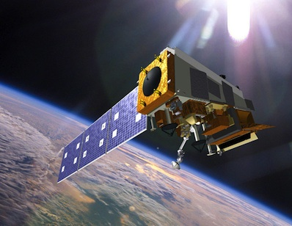
Suomi National Polar-orbiting Partnership (S-NPP)
Performance Status – April 26, 2017
Payload Instruments | Status
ATMS | G
CERES | G
CrIS | G
OMPS – Nadir | G
OMPS – Limb | G
VIIRS | G
Spacecraft Subsystem | Status
TLM, Command & Control | G
ADCS | G
EPS | G
Thermal Control | G
Communications | G
CDP | G
SCC | G
GPS | G
1553 | G
1394 | G
Spacecraft | S-NPP
Launch Date | Oct 28, 2011
Mission Category | LTAN 1330 (PM) +/- 10 mins
Operational (or capable of)
Not functional
Operational with limitations (or in standby)
Functional but turned off
Operational with degraded performance
No status reported
Additional Notes:
21-Apr-2017: All instruments operating normally and are meeting/exceeding their established performance specifications. ATMS Motor Current decreased to pre-anomaly levels on Apr 2. Engineering and Vendor are monitoring ATMS Instrument - Routine execution of twice an orbit ATMS scan drive motor reversal activities been ongoing since 18 Aug 2016 – this activity will continue indefinitely. These reversal activations are performed near high latitudes (70N, 70S, 75N, 75S, 80N, 80S) in order to provide for a more consistent placement of the reversal-induced data gaps. Note - The purpose of the ATMS scan driver motor reversal is to extend the bearing life. During each reversal activity, expect up to a one minute ATMS data outage. ATMS data resumes normally after each scan drive motor reversal activity is completed.
34

Slide 35
NESDIS OSPO – NOAA Operational Satellites
Product Status -- April 2017
 | METOP-B | NOAA-19 | S-NPP* | GOES-13 | GOES-15
Launch Date | Sept 2012 | Feb 2009 | Oct 2011 | May 2006 | March 2010
Operational Date | April 2013 | Jun 2009 | Sept 2013 (NDE) | April 2010 | December 2011
Mission Data Category | Primary (AM) | Secondary (PM) | Primary (PM) | GOES-East | GOES-West
Product Areas
Imagery | G | G | G | G | G
Radiances | G | G | G (CrIS/ATMS) | G | G
RadBud/Emissivity | G | G | G (Emissivity) | G | G
Soundings | G | G | G (CrIS/ATMS Moist and Temp Profiles) | R | G
Winds | G | G | G (VIIRS PW) | G | G
Sea Surface Temp | G | G | G (VIIRS SST) | G | G
Precipitation | G | G | G (MIRS RR+TPW) | G | G
Volcanic Ash | G | G | Future | G | G
Tropical Products | G | G | G(NTCP) | G | G
Ozone | G | G | G (OMPS TC/Profile + CrIS Ozone) | N/A | N/A
Fire and Smoke | G | G | G(Active fires and AOT) | G | G
Snow and Ice | G | G | G (Binary Snow Cover) | G | G
Vegetation | G | G | G (VIIRS Green Vegetation Fraction) | N/A | N/A
Broadcast Services | G | G | G | G | G
*NPP Products includes only those deemed operational since NDE handover Sept 26, 2013
Operational GG | G | Future S-NPP products
Operational with Issues During Reporting Period | Y | Operational with Degradation | O
Non-Operational | RR | Not Applicable | N/A
Notes:
1

Slide 36
NESDIS OSPO – Backup NOAA Satellites
Product Status -- April 2017
 | METOP-A | NOAA-18 | NOAA-15 | GOES-14
Launch Date | Oct 2006 | May 2005 | May 1998 | June 2009
Operational Date | May 2007 | Aug 2005 | Dec 1998 | N/A
Mission Data Category | Secondary (AM) | Secondary (PM) | Secondary (AM) | Storage / Space Weather
Product Areas
Imagery | G | G | G | N/A
Radiances | G | Y | Y | N/A
Radiation Budget/Emissivity | G | G | G | N/A
Soundings | Y | R | R | N/A
Winds | G | G | G | N/A
Sea Surface Temp | G | G | R | N/A
Precipitation | G | G | Y (TPW Only) | N/A
Volcanic Ash | G | G | N/A | N/A
Tropical Products | G | G | G | N/A
Ozone | G | Y | R | N/A
Fire and Smoke | G | G | G | N/A
Snow and Ice | G | G | G | N/A
Vegetation | G | G | R | N/A
Broadcast Services | Y*¹ | G | G | N/A
*²Metop-A AHRPT does not support full global coverage due to earlier failure of part of the AHRPT system
Operational GG | G
Operational with Issues During Reporting Period | Y | Operational with Degradation | O
Non-Operational | RR | Not Applicable | N/A
Notes:
1
We have terminated N-15 and N-18 soundings

Slide 37
S-NPP Internal and External Users – 2017 update
External Users | Product Types
NWS-AWIPS | NUP – VIIRS
NCEP-NCO | NUP – ATMS/CrIS/OMPS
NCEP-EMC | NUP – VIIRS
EUMETSAT | NUP – ATMS/CrIS/VIIRS
CMC | NUP – ATMS/CrIS/OMPS/VIIRS
JMA | NUP – ATMS/CrIS/OMPS
NASA-GPM | xDR – ATMS (pass-thru)
NASA-JPL | NUP - VIIRS
India-NCMWRF | NUP – ATMS/CrIS
NEP-IDP | NUP – VIIRS/ATMS-MiRS
STAR-CIRA | xDR – VIIRS (pass-thru)
STAR | NUP – ATMS/CrIS/VIIRS
NOAA-AOML | NUP – VIIRS
CLASS | NUP – VIIRS/ATMS/CrIS
JTWC | ATMS (derived)
NCEI | NUP
DoD | NUP xDR
Internal Users | Product Type
VIIRSDIST | NUPS – VIIRS
SFS | NUP xDR
NIC | xDR – VIIRS (pass-thru) NUP – ATMS
Coast Watch | NUP – VIIRS
NUCAPS | NUP – ATMS/CrIS
TOAST | NUP – ATMS/ CrIS/OMPS
Okeanos | xDR – VIIRS (pass-thru)
Blended SST | NUP - VIIRS
DAPE | NUP – ATMS/CrIS/VIIRS
Prod Mon | NUP – ATMS/CrIS/VIIRS
DDS-Legacy | Ancillary
37

Slide 38
NDE Operational Products - 2017 update
Application Short Name | Application Name | Product Name | Format | Satellite
ACSPO SST | Advanced Clear Sky Processor for Oceans (NDE) - SST | SST, Clear Sky Mask | netCDF | SNPP
AOT | Aerosol Optical Thickness | VIIRS Aerosol Optical Thickness (NDE) | BUFR | SNPP
ATMS-SDR | ATMS SDR radiances | ATMS SDR radiances 22 channels (NDE) | BUFR | SNPP
CRIS-SDR-399 | CrIS SDR radiances 399 | CrIS IR sounder SDR radiances 399 channels for NWP data assimilation (NDE) | BUFR | SNPP
CRIS-SDR-1305 | CrIS SDR radiances 1305 | CrIS IR sounder SDR radiances 1305 channels for NWP data assimilation (NDE) | BUFR | SNPP
GVF | GVF | Green Vegetation Fraction – 7 day product | Grib2 | SNPP
NUCAPS Level 2 | NOAA Unique CrIS ATMS product System Level 2 | CrIS/ATMS Atmospheric Temp Profile CrIS/ATMS Atmospheric Moisture Profile | netCDF | SNPP
NTCP | Tropical Cyclone Products | ATMS Microwave Tropical Cyclone Product | ATCF Ascii | SNPP
MIRS ATMS | Microwave Integrated Retrieval System (NDE) - ATMS | MIRS ATMS image products MIRS ATMS SND products | netCDF | SNPP
OMPS-NP | OMPS nadir profile | Ozone nadir profile (NDE) | BUFR | SNPP
OMPS-TC | OMPS total column | Ozone total column (NDE) | BUFR | SNPP
VIIRS-EDR | VIIRS EDR | VIIRS EDR (NDE) | netCDF | SNPP
VIIRS-SDR | VIIRS SDR | VIIRS SDR (NDE) | netCDF | SNPP
VIIRS Binary Snow Cover | VIIRS Binary Snow Cover | VIIRS Binary Snow Map | netCDF | SNPP
VPW | VIIRS Polar Winds | VIIRS Polar Winds | BUFR netCDF | SNPP

Slide 39
NDE Operational Products – 2017 update
Application Short Name | Application Name | Product Name | Format | Satellite
Vegetation Health | Vegetation Health Products | VIIRS Vegetation Health Products | netCDF/ Geotiff | SNPP
GAASP | GCOM AMSR2 Algorithm Software Processor | AMSR2 Radiances, Ocean, Precipitation, Sea Ice | netCDF/ BUFR | GCOM
Active Fire | VIIRS Active Fire | VIIRS Active Fire | netCDF | SNPP
Upcoming Operational Products (SPSRB schedule)
V8TOZ and V8Pro (Jun)
Enterprise VIIRS Aerosol, Cloud, and Crosphere (Jun)

Slide 40






NOAA Polar Satellite Programs Continuity of Weather Observations
Calendar Year
As of March 2017
14 15 16 17 18 19 20 21 22 23 24 25 26 27 28 29 30 31 32 33 34 35 36
08 09
10 11 12 13
NOAA – 15
60% Confidence
Suomi NPP: Suomi National Polar-orbiting Partnership JPSS: Joint Polar Satellite System Program
PFO: Polar Follow-on
NOAA – 18
60% Confidence
NOAA – 19
60% Confidence
Suomi NPP
60% Confidence
JPSS – 1
JPSS – 2
Updated March 2017
PFO/JPSS – 3
PFO/JPSS – 4
Fiscal Year
08 09 10
11 12 13 14 15 16 17 18 19 20 21 22 23 24 25 26 27 28 29 30 31 32 33 34 35 36
Approved: __________________
Assistant Administrator for Satellite and Information Services
In orbit and operating Launched before Jan 2008
Planned Mission Life, from Planned Launch Date Planned Mission Life Beyond 2036
Reliability analysis-based extended weather observation life estimate (60% confidence) for satellites on orbit for a minimum of one year -- Most recent analysis: July 2016
40

Slide 41
Product Distribution and Access (PDA) System
Full policy and forms at http://www.ospo.noaa.gov/Organization/About/access.html
Ever increasing data volume requires prioritization of users to effectively manage distribution resources and ensure effective system performance
Higher priority access will be given to organizations with:
  Mission and statutory authority
  Signed NESDIS cooperative agreements or legislative authorities
  A demonstrated timeliness requirement for near-real time data to support operational user applications
If available and sufficient, users will be directed to sources of data external to NESDIS (e.g. CIMSS). Also recommend alternatives for denied users.
Following transition to PDA system, NESDIS is reassessing the Data Access and Distribution Policy; some policy revisions are anticipated

Slide 42
Processing and Distribution with PDA
Purpose of the Production Distribution and Access (PDA) is to serve as the NESDIS enterprise distribution system for our near real-time users.
All near real time distribution except for McIDAS will be migrated to PDA. McIDAS ADDE access will remain on GEODIST systems for the foreseeable future.
GOES-16 products will be provided to the primary PDA system at NSOF
S-NPP/JPSS/GCOM-W products will be provided via PDA
All distribution will use FTPS or SFTP protocols
Other products from currently supported missions being moved from DDS
PDA Distribution Service Improvements:
Provide our organization with far greater management control and system insight over data distribution.
Ability to handle large data volumes
User managed subscriptions
  User managed search and tailoring
  Tailoring of spatial, temporal, spectral, and geographic parameters
Enhanced security controls/transfer protocols
Online/email DAR process improves internal review and decision efficiency
OSPO manages and updates international user subscriptions, same as DDS
  User training provided following approved access
  System will enable NESDIS to more easily scale to meet future distribution demands while ensuring a secure distribution framework.
42

Slide 43
PDA Ops Environment Status
NDE 2.0, PDA and EI (ESPC new network) status:
  Put into operations on Dec 5th, 2016 at 12:00 UTC
  Supported GOES-16 ABI data activations on Mar 1, 2017
  Transitioned to full operations (B2.0 transition) on Mar 8, 2017 at 15:00 UTC
Transition status
  All NDE 1.0 users are on PDA at this time; old NDE system is being decommissioned
  Next big PDA data activations expected in June when GOES-16 ABI data reaches provisional maturity

Slide 44
PDA Product Delivery Schedule
GOES-16 – June 5, 2017 for L1b and CMI from all 16 ABI channels
  All other instruments in mid-August 2017
JPSS-1 - L (~September 2017) +90 days for Key Performance Parameters
  VIIRS over Alaska, ATMS, CrIS
  Other sensor products later
GOES-NOP/POES/Other Legacy Products
  Currently about 40% of all legacy products were transferred to the PDA
  DDS will be removed from service in August/September 2017 timeframe

Slide 45
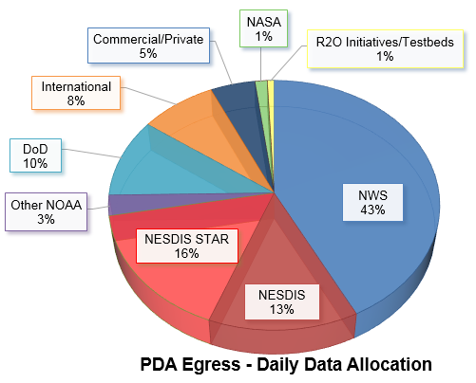
PDA Data Allocation - System Capacity Overview
PDA was initially designed with a data volume capacity egress rate of ~40 TB/day (at 25 Gbps); PDA and infrastructure is scalable to meet growing demand
As of January 30, 2017 ~41.55 TB/day has been allocated to approved users
Below is a current snapshot of PDA allocation
PDA Daily Data Allocation by Major User Category (TB/day)
NOAA | NWS | 17.65
 | NESDIS | 5.55
 | NESDIS STAR | 6.75
 | Other NOAA | 1.1
NASA |  | 0.55
DoD |  | 4.25
Commercial/Private |  | 2.0
International |  | 3.4
R2O initiatives/Testbeds |  | 0.3
Total |  | 41.55
Note - These data allocations per user are maximums and for many of the big data consumers it is unlikely they will fully utilize as much data as currently allocated over the next 12-24 months

Slide 46
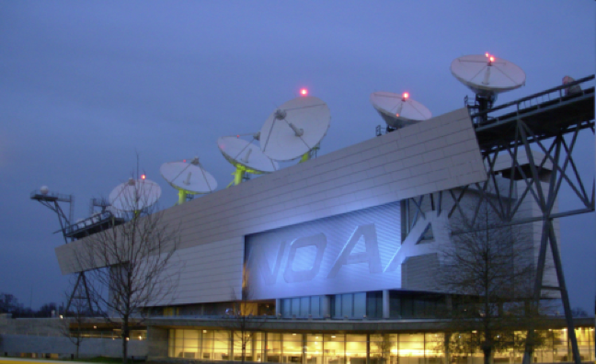
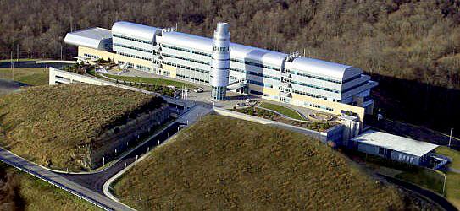
PDA Systems – Primary and COOP/Back-up
Smaller capacity operational contingency system at Consolidated Back-Up (Fairmont, West Virginia)
  S-NPP/JPSS data only (just the prime mission sensor)
  GOES-R data only available via GRB (GOES Re-Broadcast) and AWIPS
There are three PDA System Options:
  Full Operational System at NSOF
    S-NPP/JPSS, GOES-R and current mission data
  Test system at NSOF
    Internal test system only and just a few select users with periodic access

Slide 47
Non-NOAA Satellite Data on PDA
  Currently Available
    COSMIC-1 GPS Radio Occultation data for atmospheric pressure and temperature soundings
    Jason-3 OSTM data for sea surface height, wave height and wind speed
    GPM GMI level 1 and level 2 products
    GCOM-W1 AMSR2 level 2 products
  Available in Summer 2017
    Megha-Tropiques SAPHIR TPW and Rain Rate – Summer 2017
    RadarSat SAR winds and oil detection
    Sentinel-1 SAR winds and oil detection
    Sentinel-3 global SSTs and ocean color products
    Blended Hydro-meteorological products with AMSR2 capability
    In the event some were missed, all data currently on DDS will be available from the PDA

Slide 48
Non-NOAA Satellite Data on PDA
  Future
    COSMIC-2 – Late 2017 Launch (Taiwan/USAF)
    Metop-C - all instruments – Launch 2018 (EUMETSAT)

Slide 49
Thank You!

Slide 50
Back-Up/Supplemental Slides

Slide 51
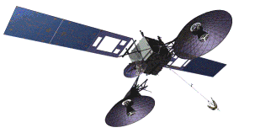
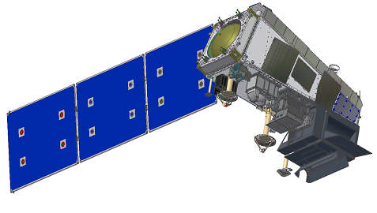
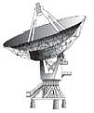

NPP S/C Communication Links
TDRS
CMD: 2067.270833 MHz
125& 1000 bps
TLM: 2247.5MHz
1.024, 4.096 or16.384 kbps
(Realtime Only)
SMD
Antenna
DB
Antenna
S-Band
Antenna
CMD2067.270833 MHz
2,000 & 128,000bps
TLM2247.5MHz
1.024, 4.096, 16.384,
32.768 kbps (Realtime)
524.288 kbps (Stored)
8.2125GHz
300.0Mbps
7.812 GHz
15 Mbps
TDRSS
Ground Link
TDRSS
White Sands Station
Direct Broadcast Downlink
Direct Readout User Terminal
Svalbard,Norway Station
Notes:
High Rate Data flow shown. Low Rate Data (LRD) antenna receive system for DRO users not included. Specs for LRD are 1.7 GHz transmission frequency and 4 Mbps data rate.

Slide 52

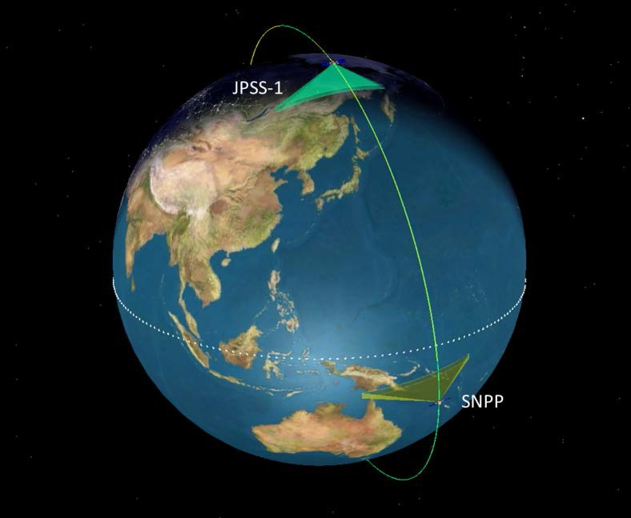
Suomi-NPP and JPSS-1
S-NPP prime ground station is SVL (located in Svalbard, Norway)
Solid State Recorder (SSR) dump every orbit (101 mins)
Tracking and Data Relay Satellite System (TDRSS) (White Sands) back-up support is available for anomaly resolution and proficiency passes
JPSS-1 prime ground stations are SVL and McMurdo (located in Antarctica)
SSR dumps twice per orbit, one complete rev down linked each dump (1/2 orbit overlap)
Ka-band also available for J-1 via TDRSS as contingency
TDRSS (White Sands) back-up support is available for LEO&A, anomaly resolution, SMD and proficiency passes
JPSS-1 will assume 1330 LTAN (PM) Orbit
Backup ground station sites are:
Fairbanks CDAS
Troll
S-NPP will be 20 minutes behind JPSS-1
Launch – Summer 2017
52

Slide 53
Operational S-NPP Products
ATMS SDR (BUFR)
  used operationally in NWS/NCEP’s Global Forecast System (May 2012)
  used operationally in ECMWF model (Sep 2012)
  used operationally in UK Met Office model (May 2013)
  JMA, CMC and India-NCMWRF are in the process of incorporating ATMS into their operational data assimilation systems
  Also available on GTS via EUMETSAT
CrIS SDR (BUFR)
  used operationally in NWS/NCEP’s Global Forecast System (Aug 2013)
  used operationally in UK Met Office model (May 2013)
  ECMWF, JMA, CMC and India-NCMWRF are in the process of incorporating ATMS into their operational data assimilation systems
  Also available on GTS via EUMETSAT
VIIRS Imagery EDRs (NetCDF4)
  Three bands, I1, I4, and I5, provided to AWIPS-2 since October 2012 and used by NWS Alaska region Weather Forecast Offices (Anchorage and Fairbanks) Also available on GTS via EUMETSAT

Slide 54
Operational S-NPP Products
Ocean Heat Content products over the North Pacific - Nov 2013
Microwave Integrated Retrieval System (MiRS) S-NPP Products (NetCDF4)
  Includes 10 products: Rain Rate, Total Precipitable Water, Cloud Liquid Water, Snow Cover, Sea Ice Concentration, Snow Water Equivalent, Land Surface Temperature, Land Surface Emissivity, Temperature and Moisture Profiles) - Dec 2013
Upgrades in GOES Solar Radiation Product Suite for Coral Reef Watch Products - Jan 2014
S-NPP Advanced Clear-Sky Processor for Oceans (ACSPO)
  Global SSTs - Feb 2014
VIIRS Polar Winds (BUFR) – June 2014
54

